Slide 1
  Budget Basics & Automated Budget Authorization-
  ABA
  UNT Dallas- Budget Office
  Budget.Office@untdallas.edu

Slide 2
Agenda
Budget Basics
Understanding the difference between ABAs and IDTs
Completing an ABA
Reviewing a Completed ABA
Approving an ABA
Finding an ABA in Cognos

Slide 3
Budget Basics

Slide 4
Chart-Strings
CHARTFIELD | Department ID | Fund Category | Fund | Function | Project | Program | Purpose | Site
Field Length | 6 | 3 | 6 | 3 | 7 | 4 | 5 | 4
Use | Who? | How? | How? | Why? | Why? | Why? | Why? | Where?
Example | 514140 Life & Health Sciences | 200 Designated-Operating Managed | 830001 Designated Tuition | 500 Student Services | 1000305 Life Sciences B Wind Study | 2702 Student Health | 11608 Team Science | 1480 UNTD Student Health
Department ID- represents the academic or operating unit responsible for the transaction
Fund Category- identifies the source of money: E&G (state), Designated (Local), Auxiliary, or Restricted.
Fund- identifies the different types of money within each source
Function- designates the purpose of the expense. It is required for federal, state, and other reporting.
Projects- are used to track activities with a finite life.
Program- is used to track formal institutional programs and initiatives.
Purpose- is used to track informal activities.
Site- identifies the physical location at which a transaction is occurring.

Slide 5

Accounts are used to identify what was purchased, or what type of revenue was received.
D-Account | Acct Level D Description | GL-Account | Description
D5010 | Salaries-Faculty/Academic FT | 50101 | Salaries-Faculty 9 Mo-FT
D5014 | Salaries-Staff | 50143 | Salaries-Staff
D5031 | Wages | 50401 | Longevity Pay
D5301 | Materials & Supplies Exp | 53001 | Supplies-Office
D5301 | Materials & Supplies Exp | 53022 | Uniforms
D5301 | Materials & Supplies Exp | 53083 | Maintenance Supplies-Plmbng
D5371 | Printing & Reproduction | 53701 | Printing Services
D5371 | Printing & Reproduction | 53731 | Publications Services
D5371 | Printing & Reproduction | 53761 | Copy Services
D5501 | Other Operating Exp | 55261 | Conference Registration
D5501 | Other Operating Exp | 80153 | I/C Postage-Exp
D5251 | Travel | 52513 | TIS Lodging
D5251 | Travel | 52533 | TOS Airfare
D5331 | Communication & Utilities | 53303 | Telecom-Monthly Charge
Resource: https://www.untsystem.edu/service-teams/finance/budget/chart-accounts-coa
Untsystem.edu Offices Finance Financial Planning & Analysis Chart of Accounts

Slide 6

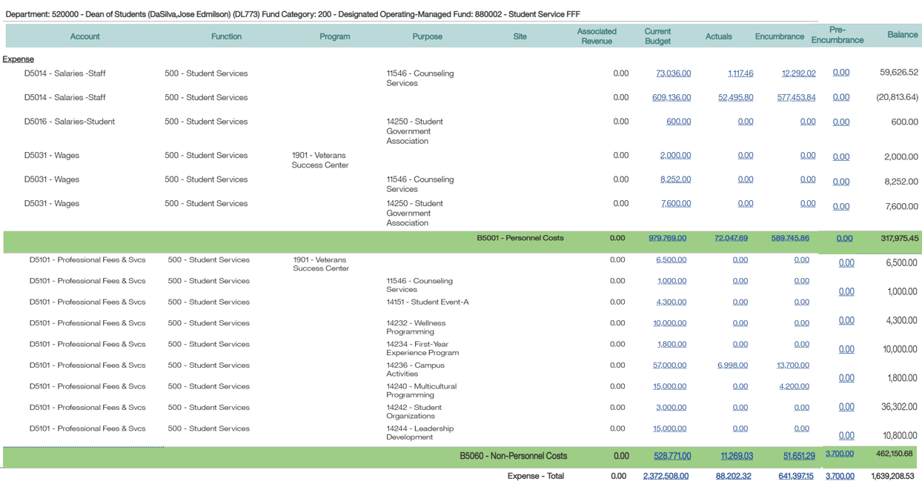
In Cognos, the chartstring is listed across the top of the Budget Report. The Account is listed in the first column of the Budget Report.
Chartstring
D-Account

Slide 7
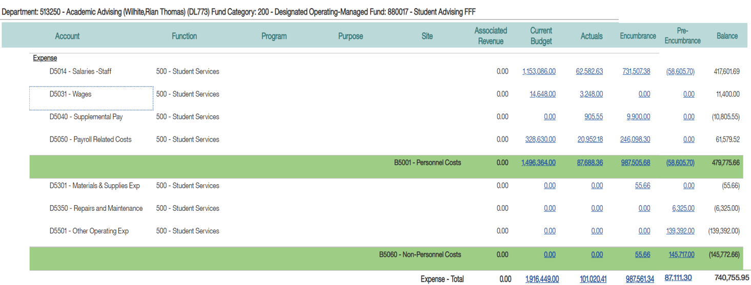
Budgetary Chartstrings
Budgetary Chartstrings are those for which the budget can be reasonably guaranteed and estimated year over year. Examples: State Appropriations, Tuition, Fees, Summer Camps, Parking, Housing.
Budgeting occurs at the D-Level
Individual D-account lines should carry a positive balance.
Budget checking occurs at the B-Level

Slide 8

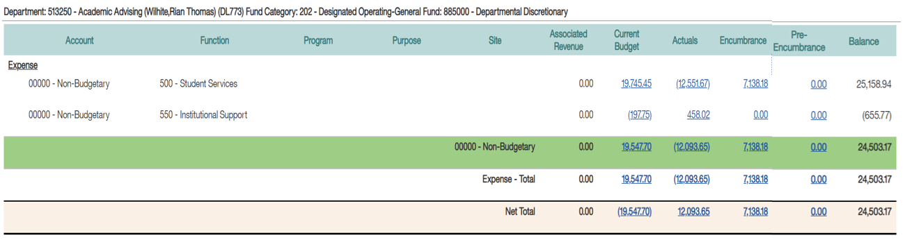
  Non-Budgetary Chartstrings are those for which the budget cannot be reasonably guaranteed and estimated year over year. Examples: Gifts, one-time speaking engagements, F&A, royalties
Budgeting does not occur. The amount in the “Budget” column simply indicates the amount of funds that rolled forward from the prior year.
Budget checking occurs at the Net Total.

Slide 9
ABAs and IDTs

Slide 10
ABAs and IDTs
Automated Budget Authorization (ABA)
A request to transfer funds or to move budget from one chartstring to another chartstring or from one D-Level account to another D-Level account.
Processed by the University Budget Office.
Interdepartmental Transaction (IDT)
A request to move a specific expense or revenue, or to purchase services from an internal cost center on campus.
Processed by the Controller’s Office.

Slide 11
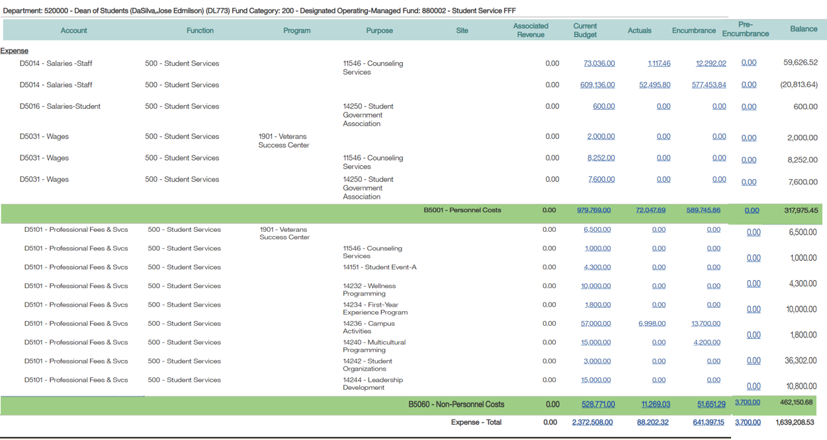
ABAs and IDTs
Budgetary Chartstrings are those with a Fund Cat = 105, 120, 200.
On Budgetary Chartstrings, ABAs are used to move funds in the Budget column. IDTs are used to move specific revenues or specific expenses (invoices, pcard charges, etc) in the Actual column.
A
B
A
I
D
T

Slide 12
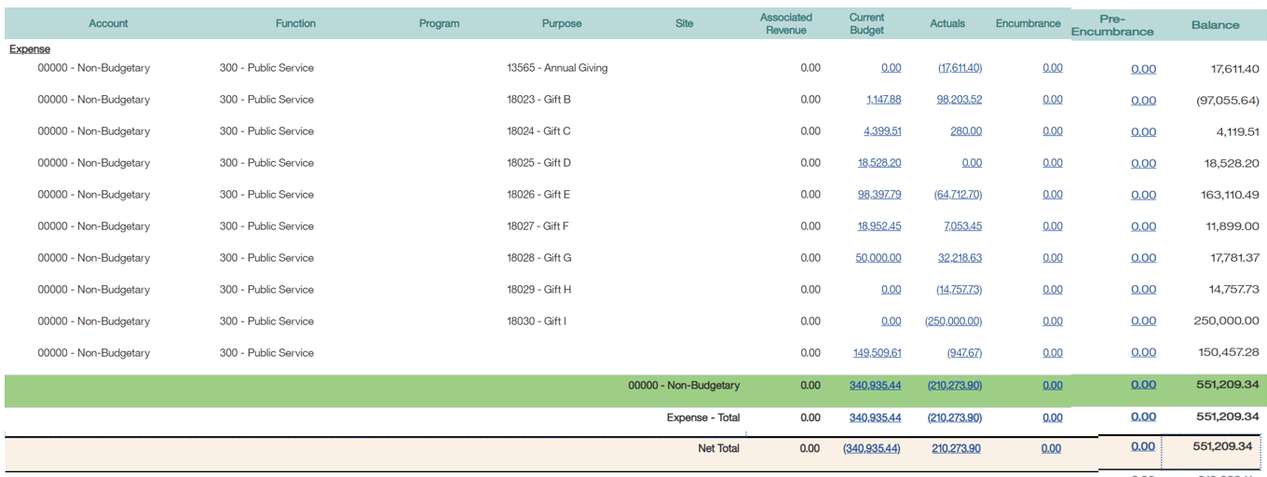
ABAs and IDTs
Non-Budgetary Chartstrings are those with a Fund Cat = 202 or higher
On Non-Budgetary Chartstrings, ABAs are used to move funds from the Total Balance. IDTs are used to move specific revenues or specific expenses (invoices, pcard charges, etc) in the Actual column.
I
D
T
ABA

Slide 13
Completing an ABA

Slide 14
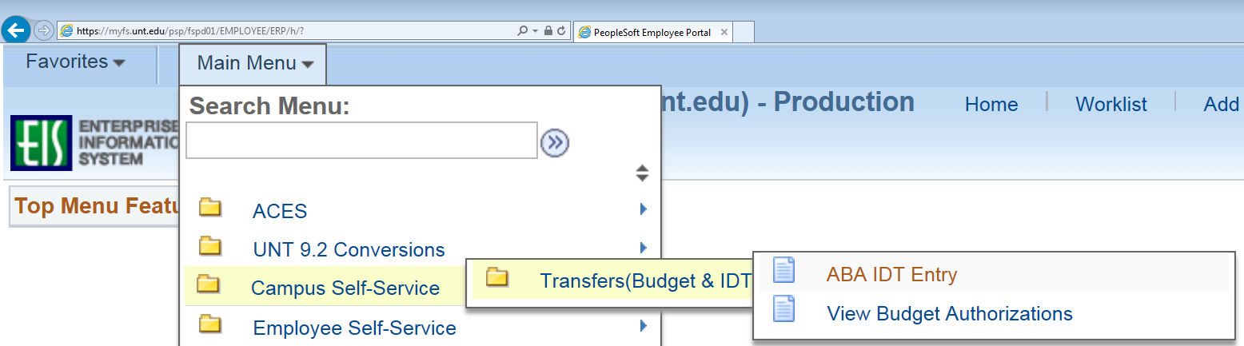
Access the ABA
1. Access the ABA in the EIS portal (myfs.unt.edu).

Slide 15
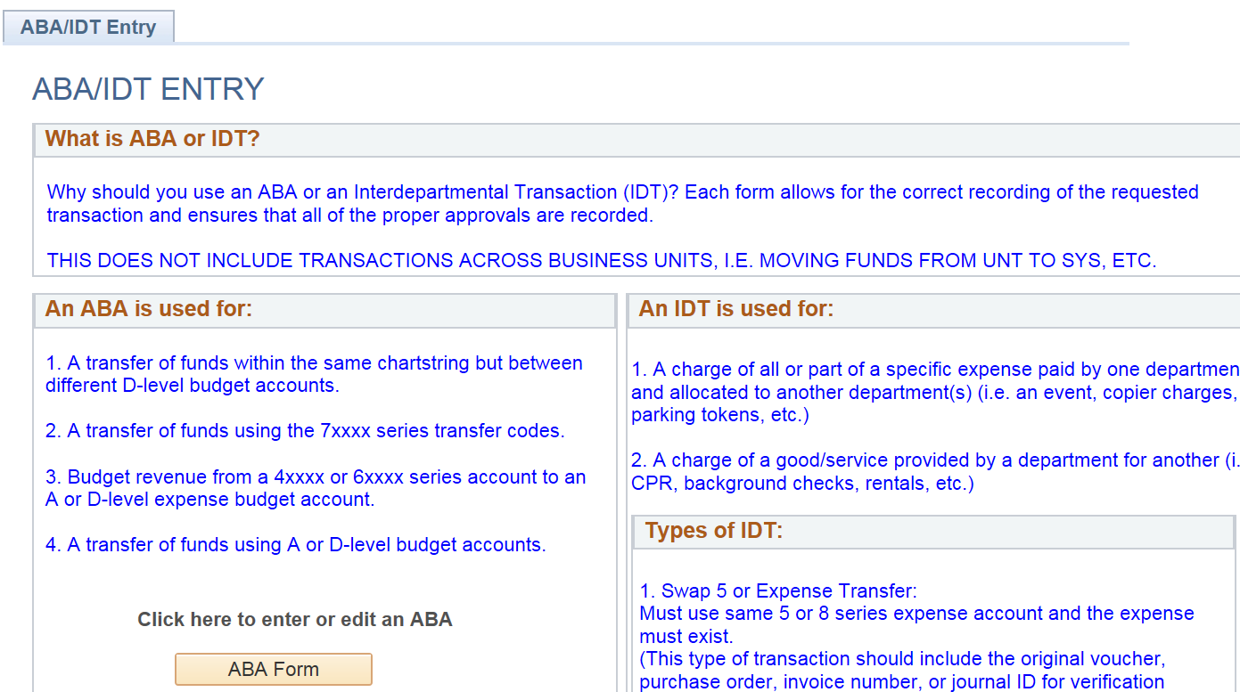
Completing an ABA
2. Click on the ABA Form button.

Slide 16
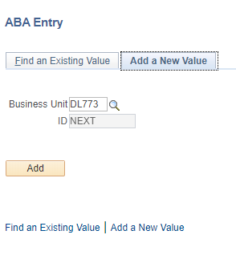
Completing an ABA
3. Click on the Add button.

Slide 17
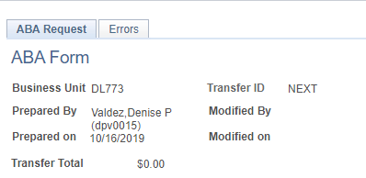
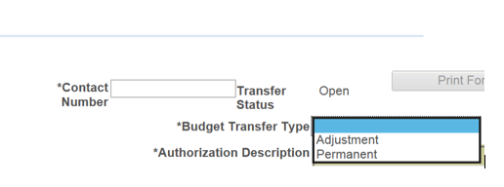
Completing an ABA
Budget Transfer Type
The Budget Transfer Type allows users to mark the ABA as Permanent or Adjustment.
Adjustment: Funds are transferred on a one-time basis.
Permanent: Funds are permanently transferred to a new chartstring so that the transferring department’s budget is reduced in both the current year and in subsequent years.
  Permanent transfers can only be performed on transfers between Budgetary Chartstrings. Budgetary chartstrings are those containing a Fund Cat equal to 105, 120, 200.

Slide 18
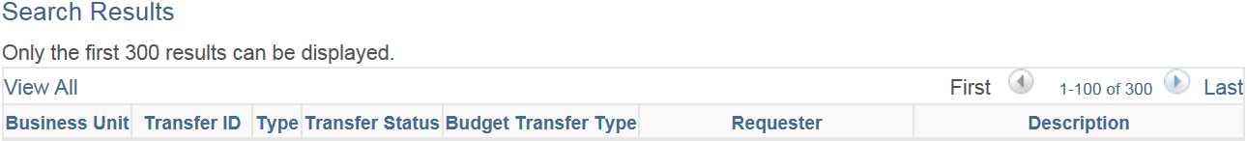

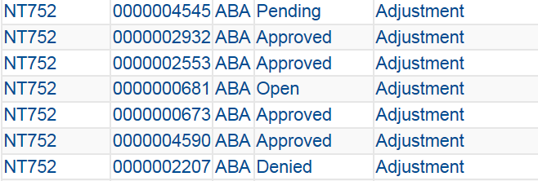
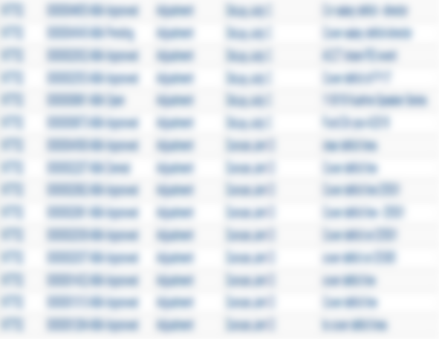
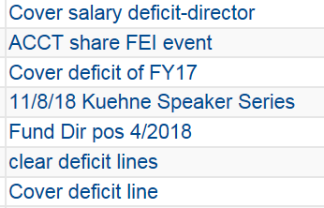
Completing an ABA
Authorization Description
Try to use a unique description for each ABA Form so that you will be able to easily find that ABA in EIS in the future.

Slide 19
Completing an ABA
Journal Line Description
The Justification is what generates the Journal Line Description and is what will be in Cognos. It is an auto-populated field limited to 30 characters.
  The first 5 characters contain the Transfer ID (aka ABA number).
  The next 25 characters are pulled from the first 25 characters of the Justification
Justification
The Justification box allows up to 250 characters and should be used to describe the ABA.
  Detailed descriptions ensure that all approvers in the Workflow, including the University Budget Office clearly understand the purpose of the ABA. This helps approvers identify any issues on the front end, rather than after the ABA is processed.
The first 25 characters will appear in Cognos. As such, ensure the first 25 characters convey the purpose of the ABA. Use the remaining 225 characters to enter a detailed description.

Slide 20
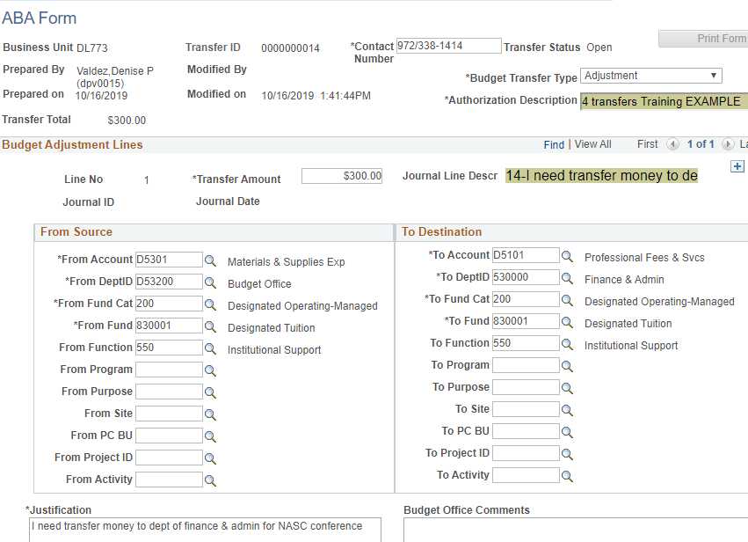
Completing an ABA

Slide 21
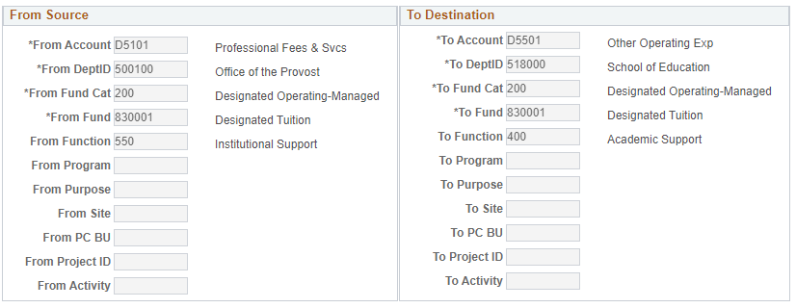
Entering the Chartstring
From Source & To Destination
From Source is the chartstring sending the money. To Destination is the chartstring receiving the money.
If a chartstring contains a Project value, the PC BU and Activity fields must be completed for that chartstring.
From Function and To Function are required.

Slide 22
Selecting an Account
From Account & To Account
The account to use depends on whether the chartstring is budgetary (Fund Cat = 105, 120, 200) or not.
The From and To chartstrings should be considered independently. For example, if the From Source chartstring is non-budgetary, use 70001 as the From Account. If the To Destination chartstring is budgetary, use a D-level account as the To Account.
FROM SOURCE Chartstring:
TO DESTINATION Chartstring:
Budgetary
(Fund Cat = 105, 120, 200)
Enter the D-Level Expense Account
Budgetary
(Fund Cat = 105, 120, 200)
Enter the D-Level Expense Account
Non-Budgetary or Project
(Fund Cat ≠ 105, 120, 200)
Enter 70001
**For sponsorships only, Enter 70005**
Non-Budgetary or Project
(Fund Cat ≠ 105, 120, 200)
Enter 70003
**For sponsorships only, Enter 70007**

Slide 23
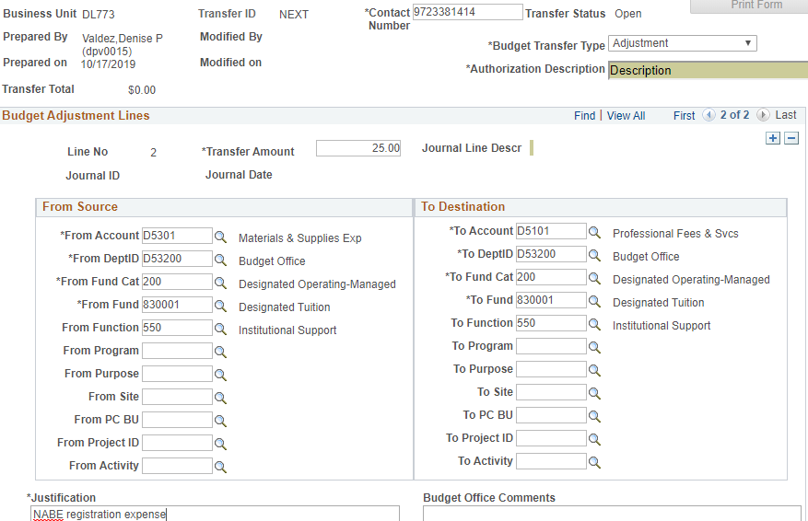
Adding lines to an ABA
You can process more than one transfer on an ABA by adding lines to the ABA. This can be done by clicking the plus sign in the right corner.

Slide 24
Adding lines to an ABA
Tips to decrease processing times when adding multiple lines
When submitting an unusual transfer request, limit additional lines (unless the additional lines are similar).
  When research is required, the entire ABA (rather than the particular line) will be delayed
When entering multiple lines:
  If one line is denied, this results to the entire ABA transaction lines are denied. Limit additional lines up to 10 lines in case if one line is denied will result to submit the 10 lines again.
  If the lines are different scenarios on the first line, please ensure that information on the justification information.

Slide 25
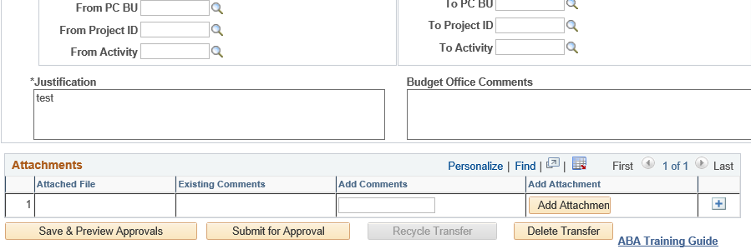
Submitting an ABA
Save & Preview Approvals – Submit for Approval
Click on “Save & Preview Approvals” to save the ABA and see who the ABA will route to for approval (the Workflow).
Click on “Submit for Approval” to submit the ABA for approval.

Slide 26
Approving

Slide 27
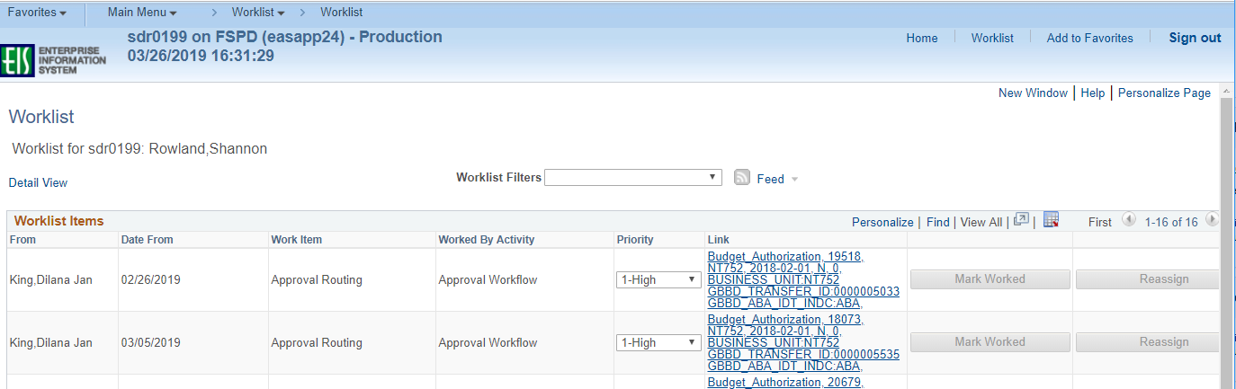
Approving an ABA
To approve an ABA you must go through your Worklist
The Worklist is located in the top right corner of EIS. Once you click on the Worklist you will see all ABAs pending your approval.
Click on the hyperlink to pull up an ABA for approval.

Slide 28
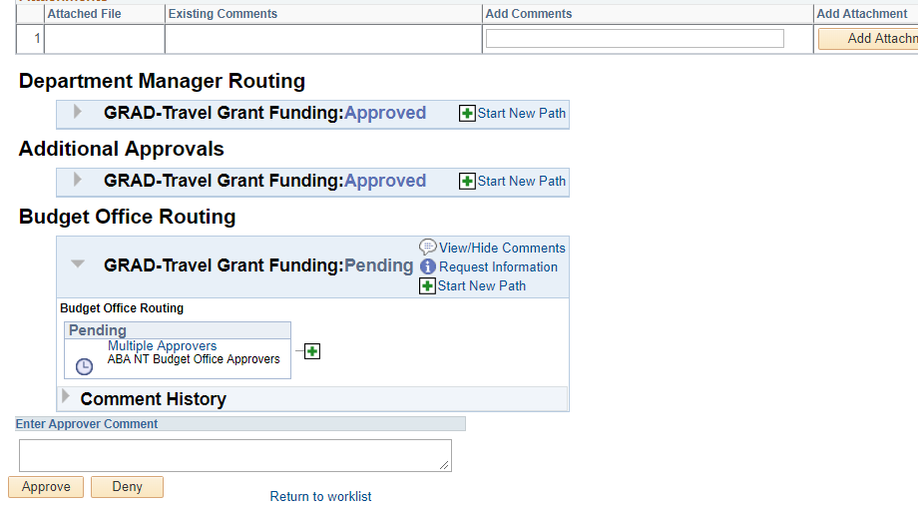
Approving an ABA
Review the transfer then Approve or Deny. Please note that a comment must be entered if an ABA is denied.

Slide 29
Finding an ABA in EIS

Slide 30
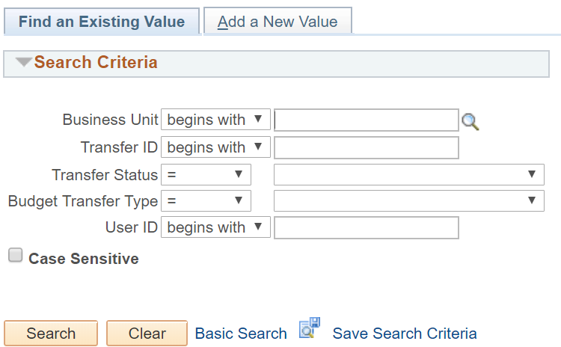
To Find ABAs
1. From the Main Menu in EIS, select Campus Self-Service > Transfers (Budget & IDT) > ABA IDT Entry. A new page will appear.
2. Click on the ABA Form button. A new page will appear.
3. Click on the Find Existing Value tab.

Slide 31
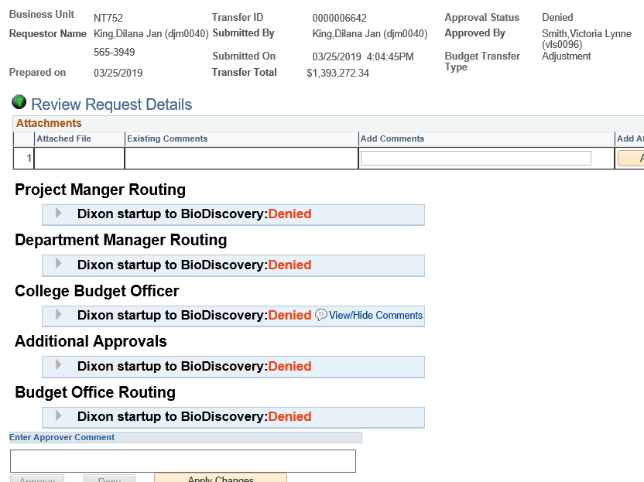

Denial Comments
To find a denial comment:
Find the ABA, and go to the approvals page
Find the line that has “View/Hide Comments”
Click on the View/Hide hyperlink

Slide 32
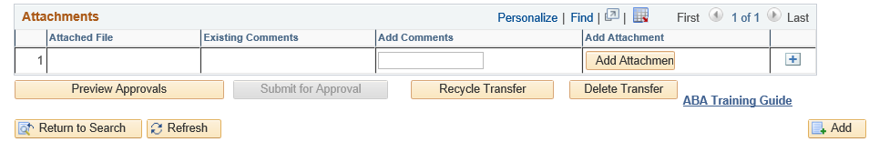
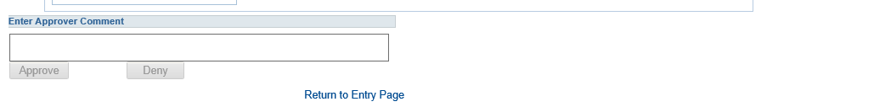
Edit & Resubmit an ABA
To pull back an ABA once submitted or to reuse a previously submitted ABA, pull up your ABA and click on Recycle Transfer. ABAs can only be recycled one time.
On the next screen click on “Return to Entry Page” located at the bottom of the page
Make necessary changes and Submit ABA for approval.

Slide 33
Finding an ABA in Cognos

Slide 34
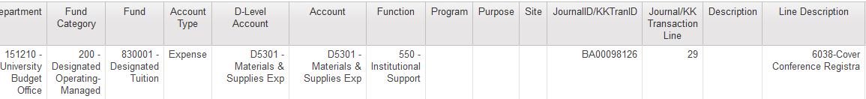
Find a Processed ABA Journal in Cognos
The line description will include your ABA # and the first 25 characters of the ABA description.
Please note: Depending on the type of transfer there could be several entries associated with one ABA. All lines will include the same line description.

Slide 35
Questions?
  UNT Dallas- Budget Office
  Budget.Office@untdallas.edu

Slide 36
  Thank You

